Slide 1


Business Process Management
VSM Future State Map
The Innovators 2
Group Members : Rahal Karunaratne – 1115765
Niriksha Sreekanth – 1216490
Aderopo Obuh – 1182239

Slide 2
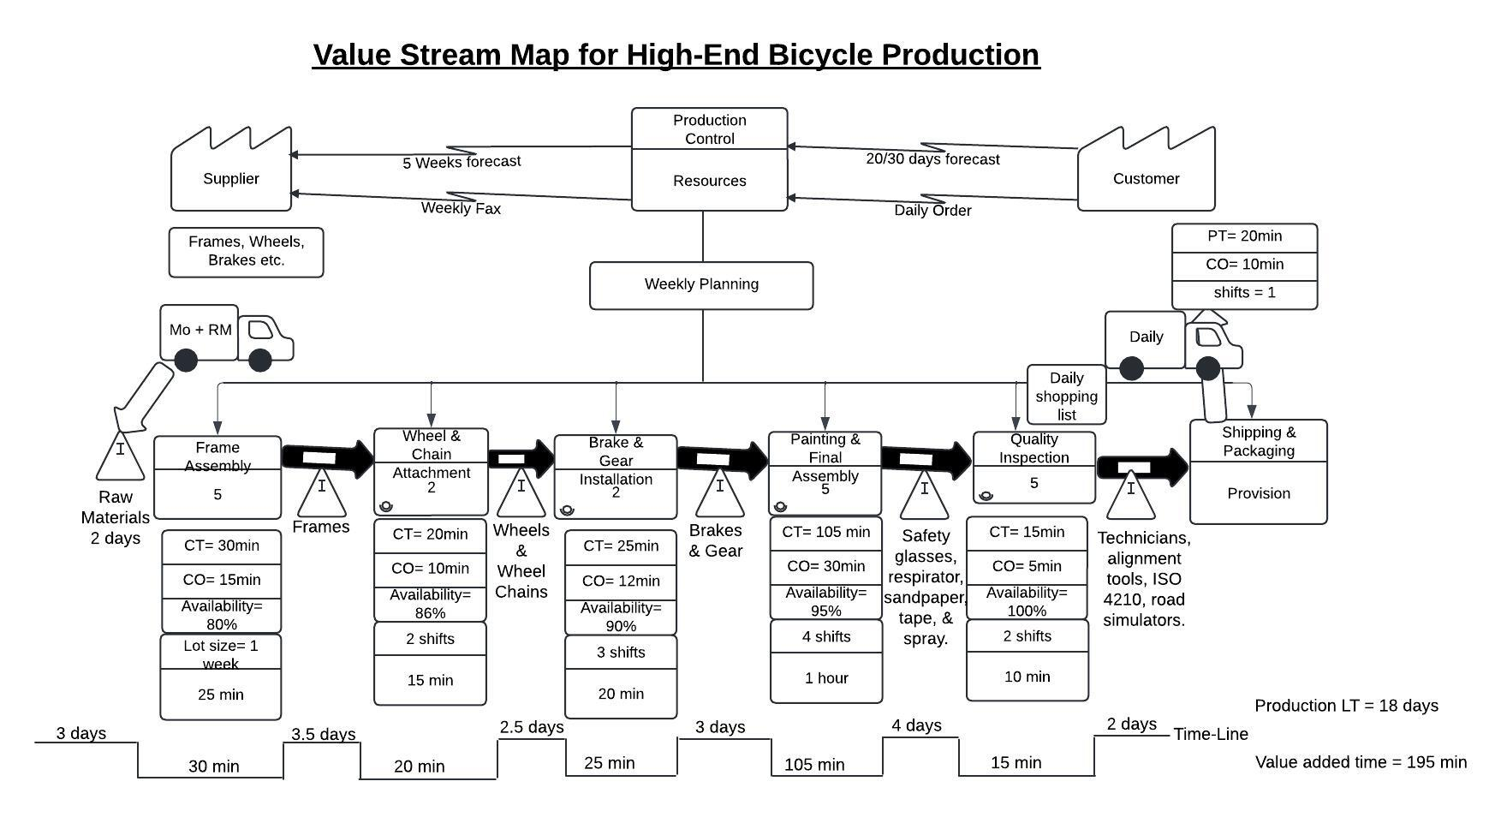
VALUE STREM MAPPING

Slide 3
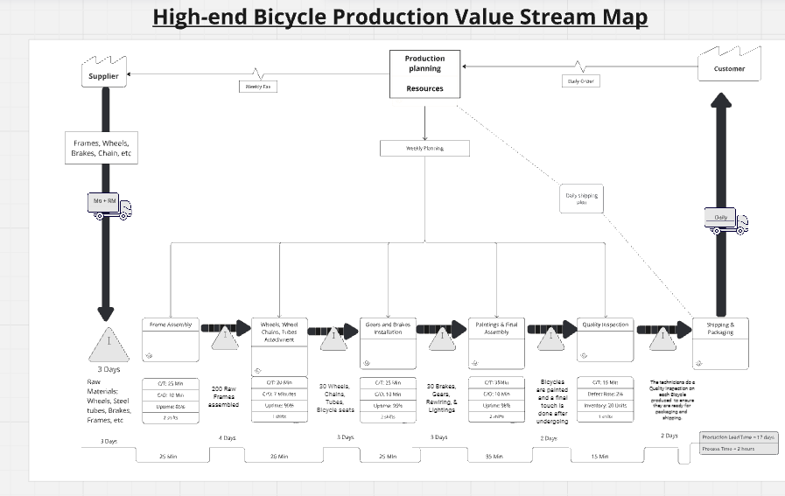
VSM Future State Map

Slide 4
Three Pain Points and Related Proposed Improvements
1. Frame Assembly Process Availability and Lot Size
Proposed Improvement: an increase in availability and a reduction in the lot size could lead to a more efficient production, and this might require a preventive maintenance measure to reduce downtime.
2. Wheel & Chain Attachment Setup Time
Proposed Improvement: by minimizing the setup time which is also the changeover time through SMED (Single-Minute Exchange of Dies) techniques, the process will be enhanced efficiently, and the overall cycle time will also reduce.
3. Painting & Final Assembly Cycle Time
Proposed Improvement: exploring ways to reduce the cycle time, such as process optimization, better tooling, or making use of an advanced painting technologies, could significantly improve the workflow and reduce bottlenecks.

